Slide 1


OG-IDN PROJECT
Does Free College Tuition Fee Increase Labor Productivity?
Aji Agus Permadi
Rani Septyarini

Slide 2



Indonesia allocates 1.3% of GDP to total education (World Bank, 2023), below UNESCO's recommended 4–6% of GDP.
Only ~12–15% of this budget goes to higher education, translating to 0.15% of GDP for tertiary education.
Indonesia's labor productivity remains significantly lower, US$14/hour.
The college graduate will earn around 60% more compared to that of senior high school graduates (Yubilianto, 2020).
Background
01

Slide 3


Research Question
To what extent does increased government spending on higher education drive labor productivity in Indonesia?
02

Slide 4





Data/Model/Calibration Detail
Education Reform: Increasing education budget through government spending by 0.13% (in term of GDP).
Changing Total Effect of Productivity by 4% (Aji, 2022)
5 years to phase in
03

Slide 5
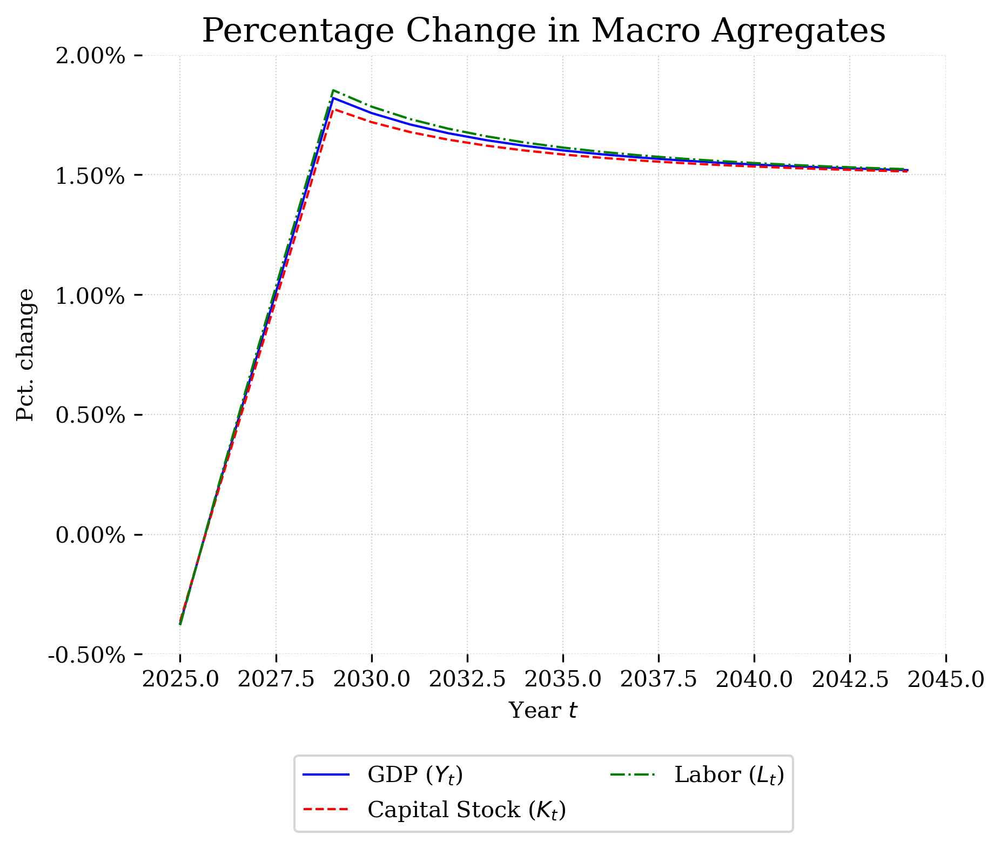


Results
Initial spike in growth following the reform.
Overtime the increase is stabilize and align closely to the baseline.
04

Slide 6
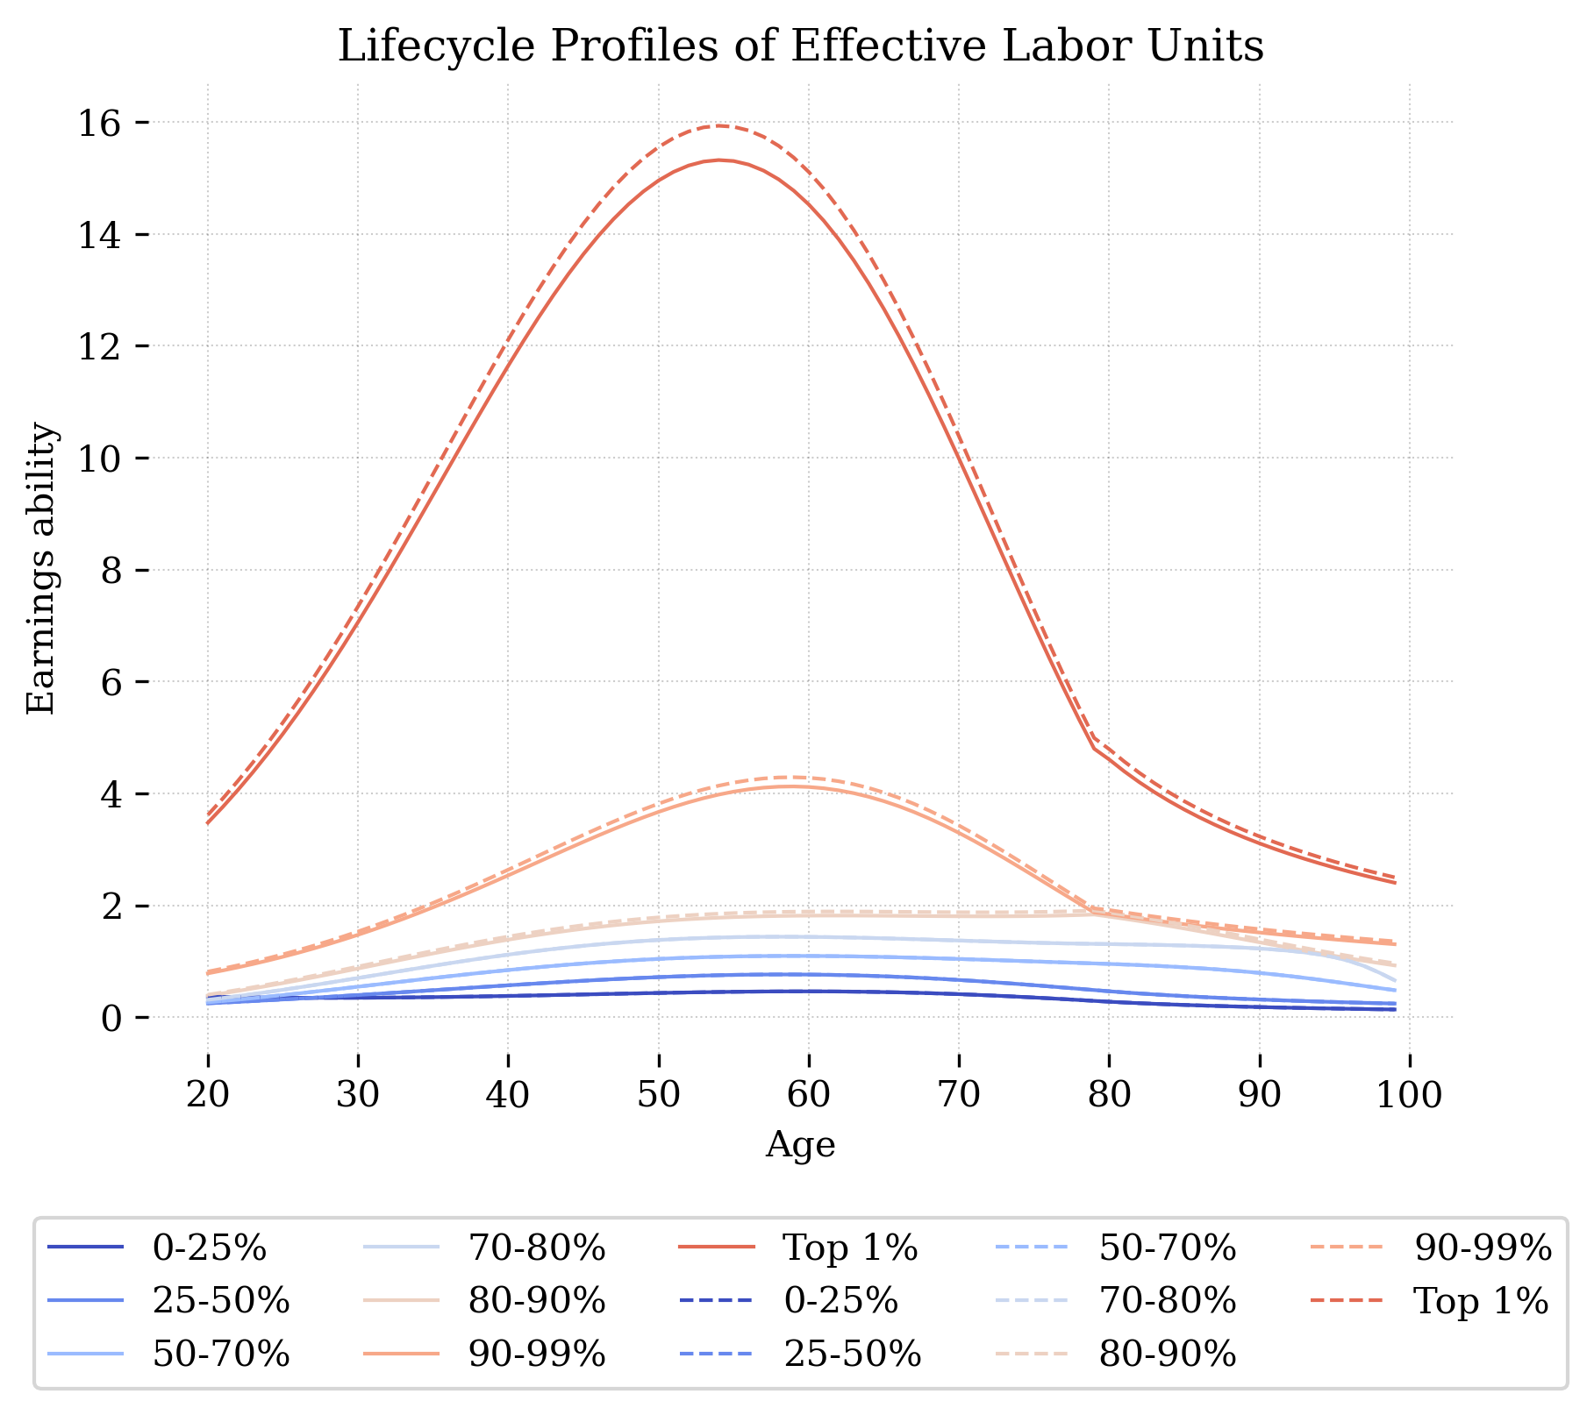
Top 1% experiencing much higher earnings ability throughout their lifecycle.
05

Slide 7
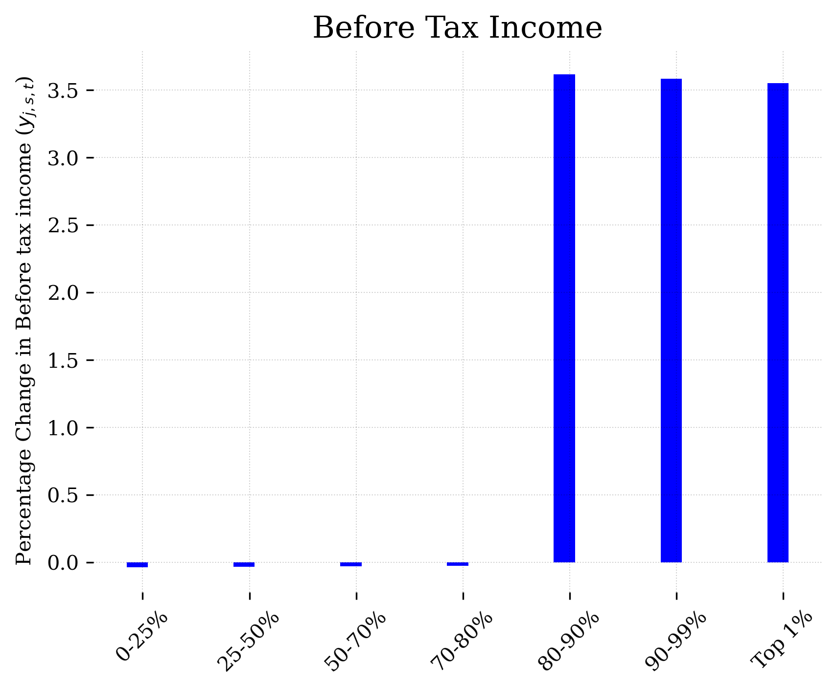
Substantial increase in income for the higher income quantiles post-reform.
06

Slide 8
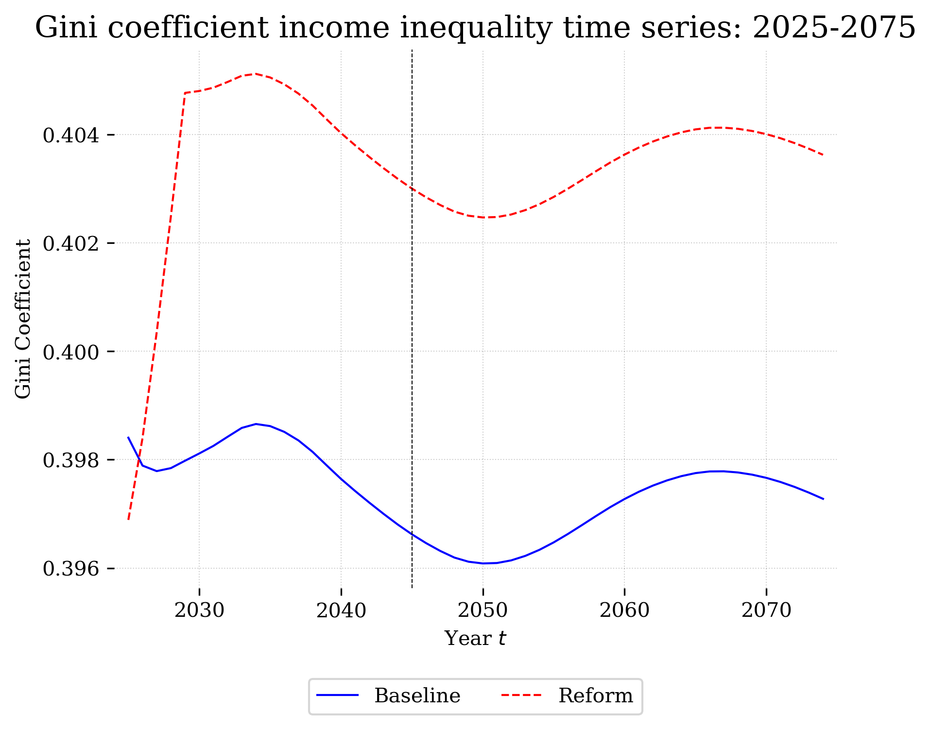
The reform scenario indicates a sharp increase in the Gini coefficient, suggesting a temporary rise in income inequality.
07

Slide 9
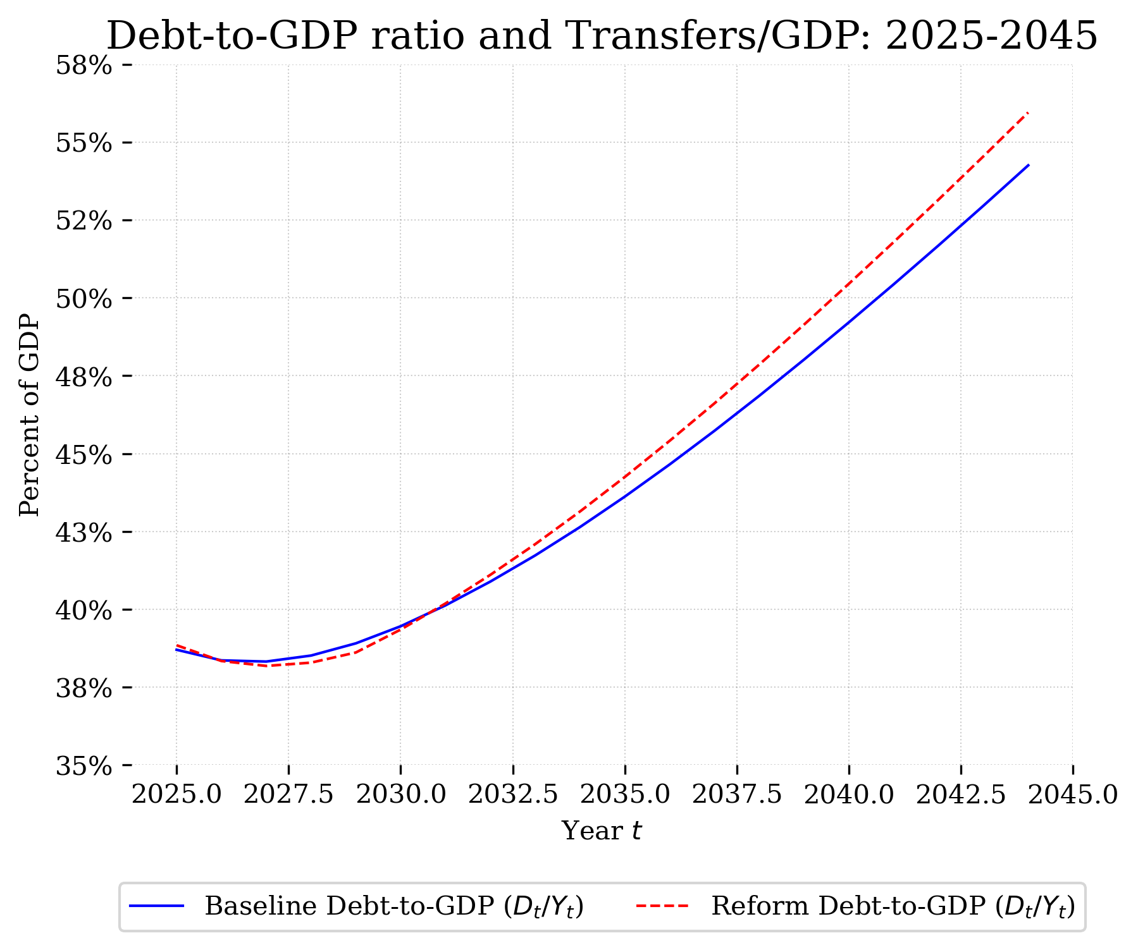
Debt to GDP decrease in the first few year. After five years, Debt to GDP ratio is increasing.
08

Slide 10
Short-term boost in economic productivity following the reform, demonstrated by spikes in GDP and capital stock, which aligns over time with baseline projections.
The reform leads to a slight increase in the debt-to-GDP ratio due to increased government spending on education.
Economic benefits are predominantly realized by higher income groups, as shown by the significant increase in their before-tax income.
Conclusion
09

Slide 11


Thank You

